Slide 1

HR RAG System
Revolutionizing HR Document Analysis with Retrieval-Augmented Generation: Empowering HR with instant, accurate information retrieval.

Slide 2
The Challenge: Reimagining HR Document Management
Current Problems
The Solution: AI-Powered Efficiency
Manual document searching
Inconsistent information retrieval
AI-powered document analysis
Time-consuming policy lookups
Instant, accurate information retrieval
Knowledge silos and accessibility issues
Natural language query interface
Outdated or conflicting information
Centralized knowledge management
Human error in document interpretation
Real-time document updates
Consistent, reliable responses

Slide 3

Solution Overview
RAG-Powered
Accurate Answers
HR Intelligence
Combines document retrieval with advanced language models.
Provides contextual answers from your HR documents.
Transforms HR processes into streamlined workflows.

Slide 4
Key Features: Comprehensive HR Document Management
Multi-format Support: PDF, DOCX, Excel, HTML documents
OCR Integration: Process scanned documents and images
Semantic Search: Understand context, not just keywords
Source Attribution: Always cite document sources
Real-time Updates: Automatic reprocessing of updated documents
Access Control: Role-based document permissions
Hybrid Search: Combine semantic and keyword search
Conversation Memory: Follow-up questions and context
Multi-language Support: Process documents in multiple languages
Analytics Dashboard: Usage insights and performance metrics
API Integration: Connect with existing HR systems
Audit Trail: Track all queries and responses

Slide 5
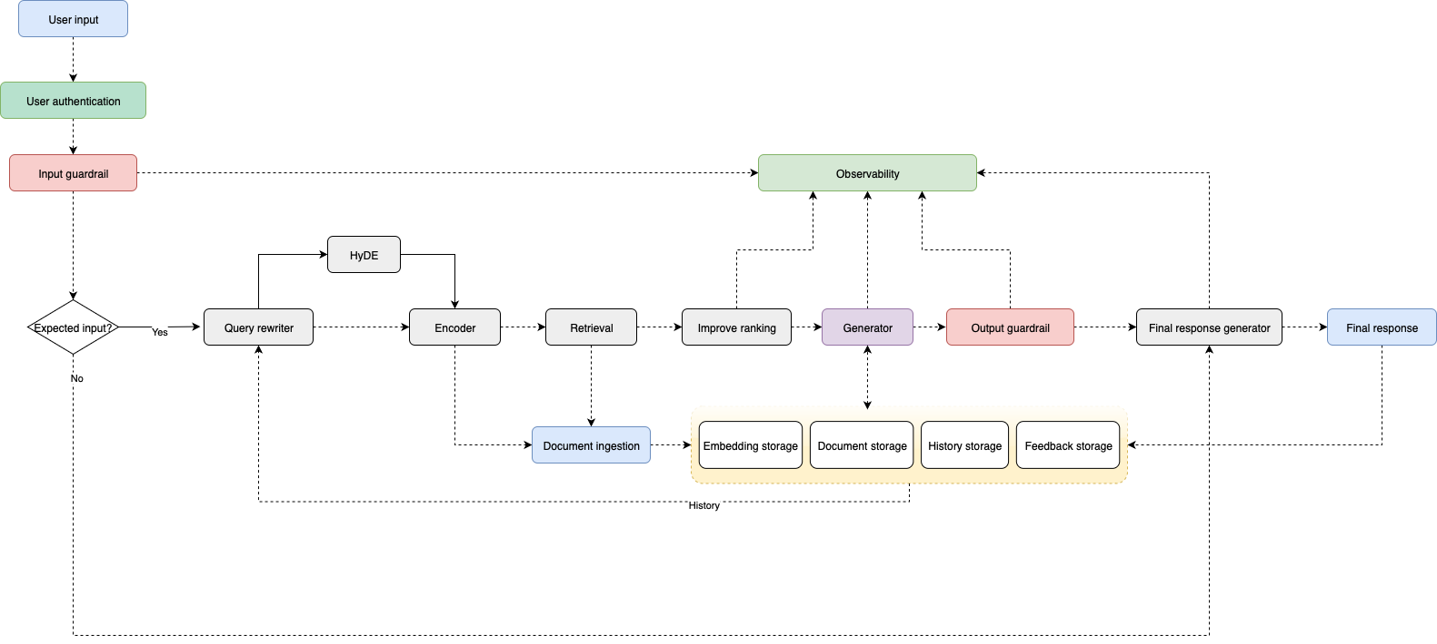
System Architecture
High-Level Architecture Overview: Data flows from various HR document sources, through processing stages like OCR and embedding generation, into a vector database. User queries are processed and matched against stored embeddings to retrieve relevant information and generate responses.

Slide 6
Technology Stack: Modern, Scalable Technologies
Core Components
Data Storage & Processing
Infrastructure & Deployment
FastAPI / Flask
Python 3.9+
Pinecone (Managed)
PostgreSQL
Uvicorn ASGI Server
Weaviate (Open Source)
Redis (Caching)
Pydantic Validation
Chroma (Lightweight)
MinIO (Object Storage)
OpenAI GPT-4
FAISS (Facebook AI)
Elasticsearch
OpenAI Embeddings
PyPDF2 / pdfplumber
Docker Containers
Sentence-BERT
python-docx
Kubernetes
Transformers
Tesseract OCR
AWS/Azure/GCP
pandas (Excel)
CI/CD Pipeline

Slide 7

Implementation Roadmap: Phased Approach to Deployment
Phase 1: Core Functionality
Basic document processing, vector store setup, simple Q&A API.
Phase 2: Advanced Features
Advanced retrieval algorithms, web UI, access control, integration.
Phase 3: Optimization & Deployment
Performance optimization, monitoring, production deployment, training.

Slide 8




Business Benefits: Transforming HR Operations
Time Savings
80% reduction in time spent searching for information.
Reduced Queries
50% fewer repetitive HR queries.
Scalability
Scalable to handle any number of users.
Automated document processing reduces manual work. Consistent answers reduce policy confusion. 24/7 availability for employee queries. Accurate source attribution and audit trails for compliance.

Slide 9
Use Cases: Real-World Applications
Benefits enrollment questions
Leave policy clarifications
Expense reimbursement procedures
Performance review guidelines
Policy interpretation assistance
Example Query: "What is the remote work policy for employees with less than 6 months tenure?"
System Response: "Based on the Employee Handbook (Section 4.2), employees with less than 6 months tenure are eligible for remote work up to 2 days per week, subject to manager approval and successful completion of the remote work training program."
Compliance requirement lookups. Training material queries. Frequently asked questions analysis. Personalized responses based on role.

Slide 10
Security & Compliance: Enterprise-Grade Security
Role-based access control for document permissions
End-to-end encryption for data in transit and at rest
Multi-factor authentication support
Regular security audits and penetration testing
Secure API endpoints with rate limiting
Data anonymization for sensitive information
GDPR compliance for employee data protection
SOC 2 Type II certification
HIPAA compliance for health-related documents
Audit trails for all system interactions
Privacy First: All sensitive information is processed with strict privacy controls, ensuring employee data protection while maintaining system functionality.

